Slide 1


EcoSort
AI
AI-Powered Waste Classification & Automation

Slide 2

Overview
01 - The Problem
02 - Our Solution
03 - Components Used
04 - How It Works
05 - Key Features
06 - Target Market
07 - AI Development
08 - Competitive Advantage

Slide 3


01 - Problem Statement
Current recycling systems are inefficient and often rely on manual sorting.
Misclassification leads to contamination and reduces the value of recyclables.
Labor costs and human error are high in waste management.

Slide 4

The problem
Waste Generation in Egypt
Egypt produces approximately 100 million tons of waste annually, constituting a significant portion of municipal waste.
Urban areas achieve waste collection rates up to 85%, while rural regions lag at 35%.
Waste Disposal Challenges
An estimated 80-88% of municipal waste ends up in open dumpsites.
Only about 7% is directed to sanitary landfills.
Environmental Impact
Inefficient waste management contributes to pollution, health hazards, and loss of recyclable materials.

Slide 5
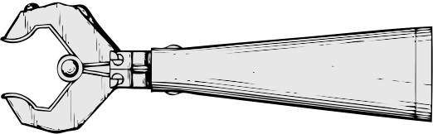

02 - Our Solution
Smart Recycling Bin
Utilizes AI-powered image classification to identify and sort waste into categories: paper, glass, metal, and trash.
Integrates with a microcontroller to physically direct waste to the appropriate compartment.

Slide 6
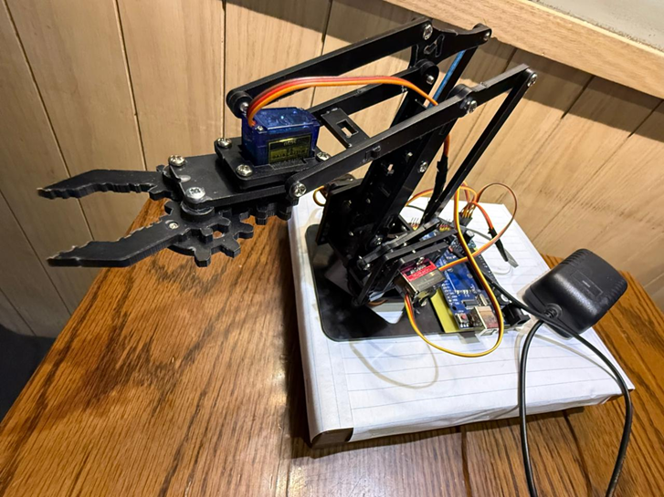
Benefits
Enhances recycling efficiency.
Reduces human error in waste sorting.
Provides environmental sustainability.

Slide 7
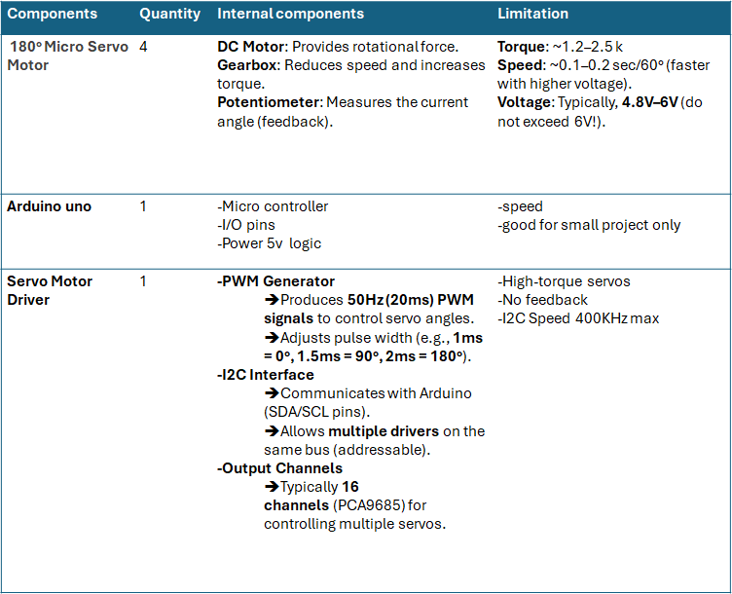
03 - Components Used

Slide 8

04- How it works
Waste detection
The ultrasonic sensor will sense when an item is placed in front of it.
The camera captures an image of the item.
AI Classification
The AI model processes the image and classifies the waste type.
Mechanical Sorting
The microcontroller receives the classification result and actuates the mechanism to direct the waste to the correct bin.

Slide 9

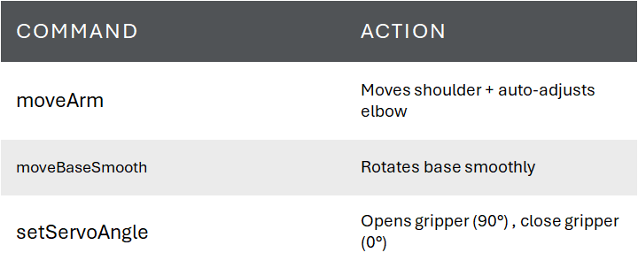
Servo Motor Functions

Slide 10


05- Key Features
Real-Time Processing
Immediate classification and sorting of waste items.
High Accuracy
Achieved a validation accuracy of 91% during model training.
Scalability
Design allows for easy scaling and integration into various settings.

Slide 11

06 - Target Market
Primary Markets
Urban municipalities aiming to improve waste management.
Educational institutions promoting environmental awareness.
Corporate campuses seeking sustainable waste solutions.
Market Potential
Egypt's plastic recycling market was valued at USD 380.25 million in 2024 and is expected to reach USD 473.96 million by 2030, indicating a growing demand for recycling solutions.

Slide 12

07- AI Development
Dataset
Utilized the TrashNet dataset from Kaggle, comprising images of various waste categories.
Challenges Faced
Data Imbalance: Certain classes, like paper and metal, were underrepresented.
Overfitting: The model performed well on training data but poorly on unseen data due to low sample diversity.
Solutions Implemented
Data Augmentation: Applied techniques like rotation, scaling, and flipping to increase dataset diversity.
Regularization: Introduced dropout layers to prevent overfitting.

Slide 13

Two-Phase Training
Transfer Learning
Used a pretrained model (VGG16) to extract useful low-level features like edges, textures, and shapes
Froze all convolutional layers and trained custom dense layers for classification
Chosen for efficiency and robustness given our limited dataset
Fine-Tuning
Unfroze the last 4 layers of VGG16 to adapt the model to our dataset
This improved our model’s ability to distinguish similar materials and better adapt to real-world waste images.
Results
Training accuracy: ~91%
Validation accuracy: ~82%

Slide 14
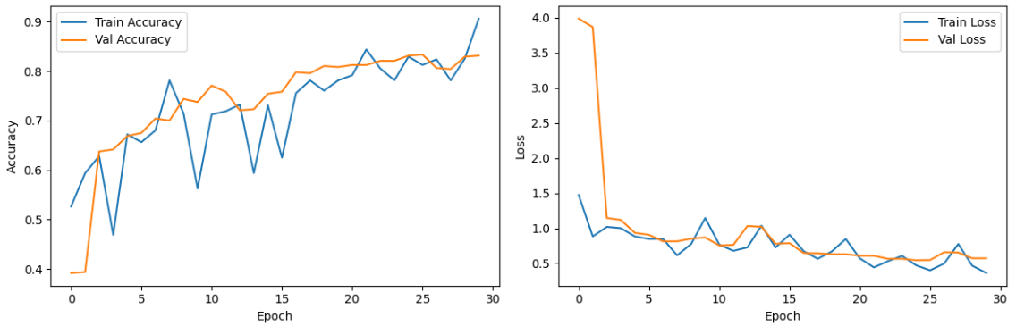
Analysis

Slide 15

09 - Competitive Advantage
Innovative Integration
Combines AI with mechanical systems for automated waste sorting.
Cost-Effective
Reduces the need for manual labor in waste management.
Environmental Impact
Promotes recycling and reduces landfill usage.
Adaptability
System can be adapted to recognize additional waste categories as needed.

Slide 16
Thanks

